Slide 1
NEO4J CYPHER TUTORIAL WITH PYTHON
Run Neo4j Inside Docker Container
Tutorial 74

Slide 2
How to run Neo4j inside docker container
Download neo4j image from docker hub
https://hub.docker.com/_/neo4j/.

Slide 3
How to access Neo4j cypher shell running inside docker container
Accessing neo4j shell
docker exec -it neo4j-test sh

Slide 4
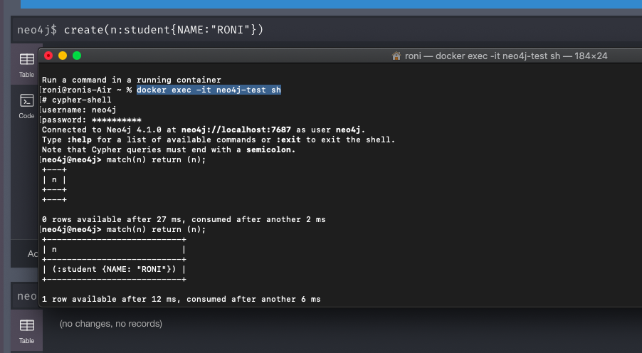
How to access Neo4j cypher shell running inside docker container
Accessing neo4j shell

